Slide 1

FPT University
Android programMing
Lesson 6
Version 1.0

Slide 2
Agenda
Android Fragments
Creating and Managing Overflow Menus on Android

Slide 3
Android Fragments
What is a Fragment?
- A fragment is a self-contained, modular section of an application’s user interface and corresponding behavior that can be embedded within an activity
- Fragments may only be used as part of an activity and cannot be instantiated as standalone application elements. Fragment can be thought of as a functional “sub-activity” with its own lifecycle similar to that of a full activity

Slide 4
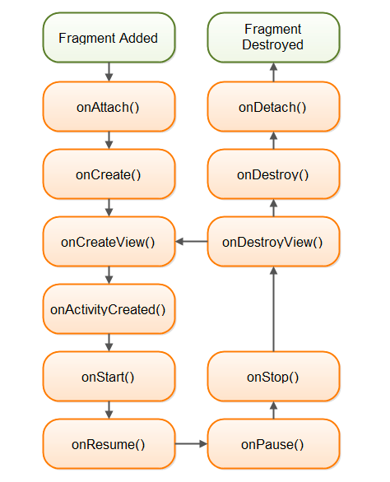
Android Fragments
Fragment lifecycle

Slide 5
Android Fragments
Adding a Fragment to an Activity using the Layout XML File
activities using fragments must be implemented as a subclass of FragmentActivity instead of the AppCompatActivity class

Slide 6
Android Fragments
public class FragmentDemoActivity extends FragmentActivity { @Override protected void onCreate(Bundle savedInstanceState) { super.onCreate(savedInstanceState); setContentView(R.layout.activity_fragment_demo); } }
<?xml version="1.0" encoding="utf-8"?> <android.support.constraint.ConstraintLayout xmlns:android="http://schemas.android.com/apk/res/android" xmlns:app="http://schemas.android.com/apk/res-auto" xmlns:tools="http://schemas.android.com/tools" android:layout_width="match_parent" android:layout_height="match_parent" tools:context=".FragmentDemoActivity"> <fragment android:id="@+id/fragment_one" android:name="com.example.fu.testing.FragementExample" android:layout_width="match_parent" android:layout_height="wrap_content" tools:layout="@layout/fragement_example" /> </android.support.constraint.ConstraintLayout>

Slide 7
Android Fragments
Implement OnFragmentInteractionListener
onAttach method on Fragment mention that the OnFragmentInteractionListener event must be implement on attached activity
public class FragmentDemoActivity extends FragmentActivity implements FragmentDemo.OnFragmentInteractionListener{ ......... @Override public void onFragmentInteraction(Uri uri) { } }

Slide 8
Android Fragments
Handling Fragment Events
Where’s the view on fragment’s events handled?
- The answer to this question depends on how the event handler is declared. If the android:onClick resource is used, however, the event will be passed directly to the activity containing the fragment

Slide 9
Android Fragments
In case that the event need to handle in fragment code. It must be implement on override method OnViewCreated
@Override public void onViewCreated(@NonNull View view, @Nullable Bundle savedInstanceState) { super.onViewCreated(view, savedInstanceState); Button button = getView().findViewById(R.id.button); button.setOnClickListener(new View.OnClickListener() { @Override public void onClick(View v) { ((TextView)getView().findViewById(R.id.textView)).setText("Fragment"); } }); }

Slide 10
Android Fragments
Fragment can be add, remove, or replace in code
fragmentDemo = new FragmentDemo(); fragmentDemo.setArguments(getIntent().getExtras()); FragmentManager fragManager = getSupportFragmentManager(); FragmentTransaction transaction = fragManager.beginTransaction(); transaction.add(R.id.Fragment_Demo_Activity_Layout,fragmentDemo); transaction.commit(); FragmentTwo fragmentTwo = new FragmentTwo(); transaction = fragManager.beginTransaction(); transaction.replace(R.id.Fragment_Demo_Activity_Layout,fragmentTwo); transaction.addToBackStack(null); transaction.commit();

Slide 11
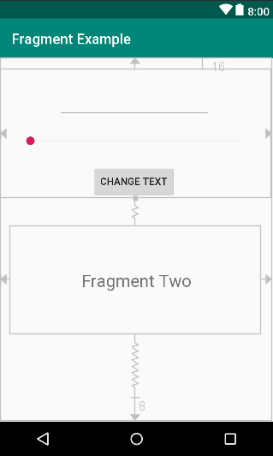
Fragment Example
About example
In this example, the application will contain two fragments. The first fragment will be toolbar fragment, and second is a text fragment. Whenever CHANGE TEXT button is clicked, the text in second fragment will be change according to the text and the value of seek bar on first fragment.

Slide 12
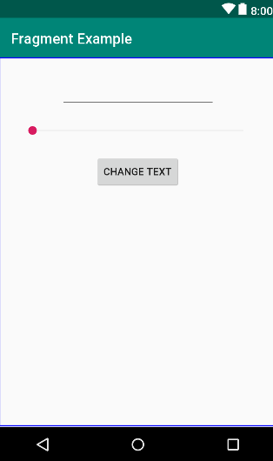
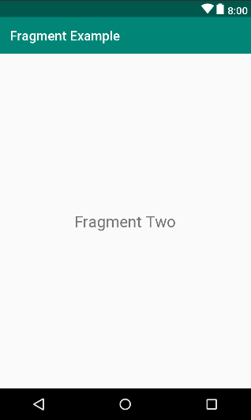
Fragment Example
To create these fragments, relative layout will be used.

Slide 13
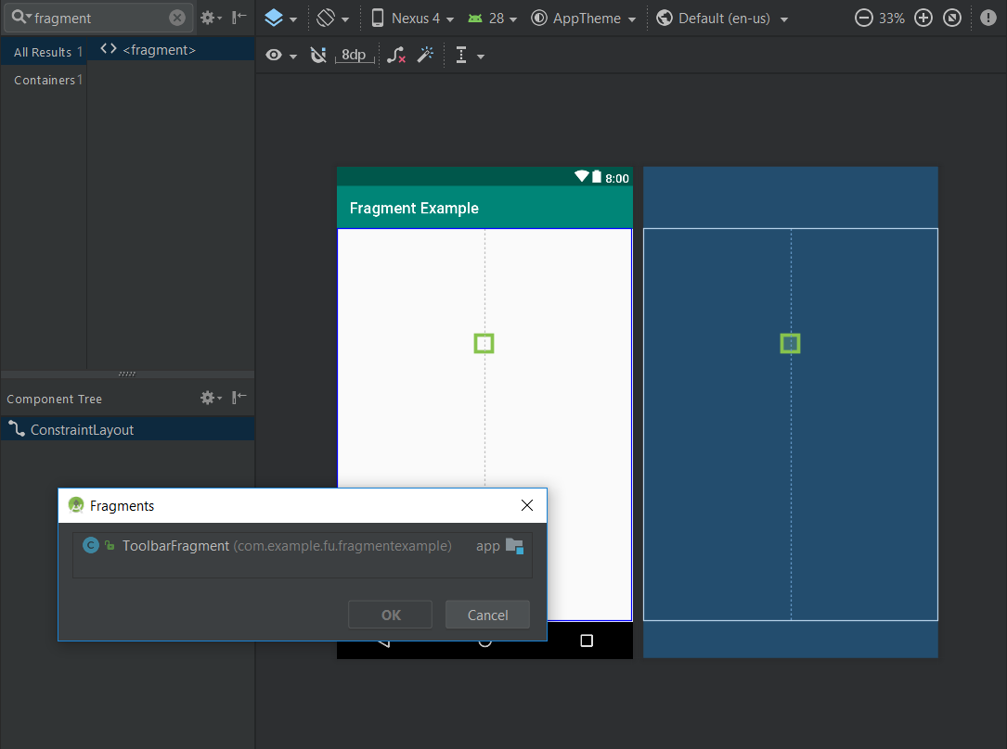
Fragment Example
To adding the fragments into main activity, let’s drop <fragment> item from view palette. After drag and drop, IDE will be let us choose the type for the new fragment.

Slide 14
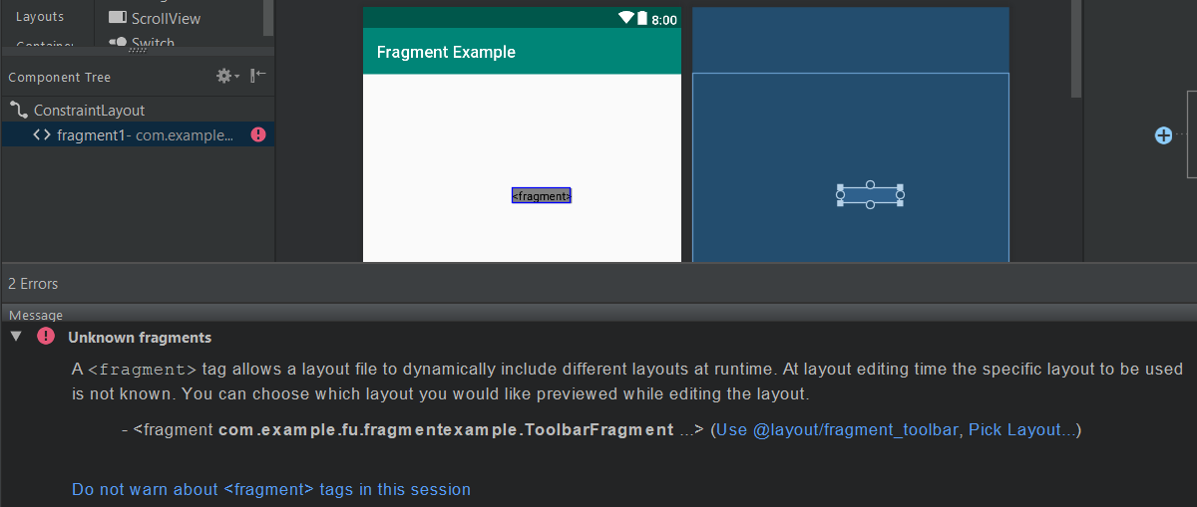
Fragment Example
An error will appear to inform that the layout of new fragment is missing and let us pick the layout for new fragment.

Slide 15
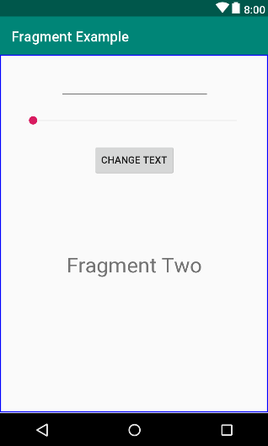
Fragment Example
After add two fragments, the main activity should look like the picture. We now done for design stage. Let’s code!

Slide 16
Fragment Example
Making the Toolbar Fragment Talk to the Activity
public class ToolbarFragment extends Fragment implements SeekBar.OnSeekBarChangeListener { ...... private static int seekvalue = 10; private static EditText edittext; ToolbarListener activityCallback; public interface ToolbarListener { public void onButtonClick(int position, String text); } ...... }
@Override public void onProgressChanged(SeekBar seekBar, int progress, boolean fromUser) { seekvalue = progress; }

Slide 17
Fragment Example
Initial for the views
@Override public void onViewCreated(View view, Bundle savedInstanceState) { super.onViewCreated(view, savedInstanceState); edittext = getView().findViewById(R.id.editText); final SeekBar seekBar = getView().findViewById(R.id.seekBar); seekBar.setOnSeekBarChangeListener(this); Button button = getView().findViewById(R.id.button); button.setOnClickListener(new View.OnClickListener() { @Override public void onClick(View v) { activityCallback.onButtonClick(seekvalue, edittext.getText().toString()); } }); }

Slide 18
Fragment Example
Attach the ToolbarListioner on activity callback
@Override public void onAttach(Context context) { super.onAttach(context); if (context instanceof OnFragmentInteractionListener) { mListener = (OnFragmentInteractionListener) context; activityCallback = (ToolbarListener) context; } else { throw new RuntimeException(context.toString() + " must implement OnFragmentInteractionListener"); } }

Slide 19
Fragment Example
Change the text in text fragment
public class TextFragment extends Fragment { private static TextView textview; public void changeTextProperties(int fontsize, String text) { textview.setTextSize(fontsize); textview.setText(text); } ...... }

Slide 20
Fragment Example
Join these pieces together
public class FragmentExampleActivity extends AppCompatActivity implements ToolbarFragment.ToolbarListener, TextFragment.OnFragmentInteractionListener,
ToolbarFragment.OnFragmentInteractionListener{ @Override public void onButtonClick(int fontSize, String text) { TextFragment textFragment =(TextFragment) getSupportFragmentManager().findFragmentById(R.id.text_fragment); textFragment.changeTextProperties(fontSize, text); } @Override public void onFragmentInteraction(Uri uri) { } }

Slide 21
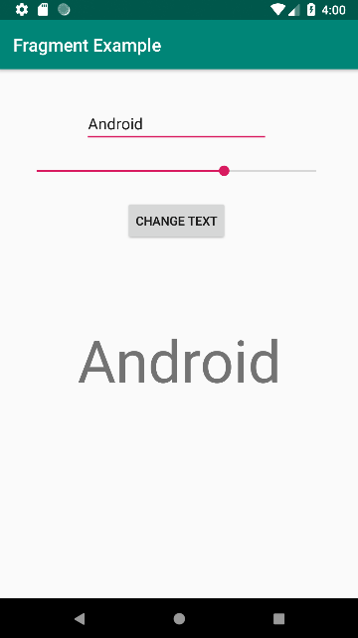
Android Fragments
Testing application

Slide 22
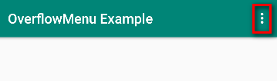
Creating and Managing Overflow Menus
The Overflow Menu The overflow menu (options menu) is a menu that is accessible to the user from the device display and allows the developer to include other application options beyond those included in the user interface of the application.

Slide 23
Overflow Menu Example
For the example project, basic activity will be used and remove the floating action button.

Slide 24
Overflow Menu Example
Creating an Overflow Menu
Create directory menu under the directory res
Create Android resource file with resource type as Menu

Slide 25
Overflow Menu Example
Add item for menu
<menu xmlns:android="http://schemas.android.com/apk/res/android" xmlns:app="http://schemas.android.com/apk/res-auto" xmlns:tools="http://schemas.android.com/tools" tools:context= ".MenuExampleActivity" > <item android:id="@+id/menu_setting" android:orderInCategory="2" app:showAsAction="never" android:title="Setting"/> <item android:id="@+id/menu_help" android:orderInCategory="3" app:showAsAction="never" android:title="Help"/> </menu>

Slide 26
Overflow Menu Example
Displaying an Overflow Menu
@Override public boolean onCreateOptionsMenu(Menu menu) { getMenuInflater().inflate(R.menu.menu,menu); return super.onCreateOptionsMenu(menu); }

Slide 27
Creating and Managing Overflow Menus
Handle menu event
@Override public boolean onOptionsItemSelected(MenuItem item) { Intent intent; switch (item.getItemId()) { case R.id.menu_setting: // Red item was selected intent = new Intent(this, Setting.class); startActivity(intent); return true; case R.id.menu_help: // Green item was selected intent = new Intent(this, Help.class); startActivity(intent); return true; default: return super.onOptionsItemSelected(item); } }

Slide 28
Creating and Managing Overflow Menus
Testing application

Slide 29

End of Lesson 6

Slide 30
Thank you!

